Slide 1
Truck&Trailer Trajectory generation via Reinforcement Learning

Slide 2
Introduction on Reinforcement Learning

Slide 3
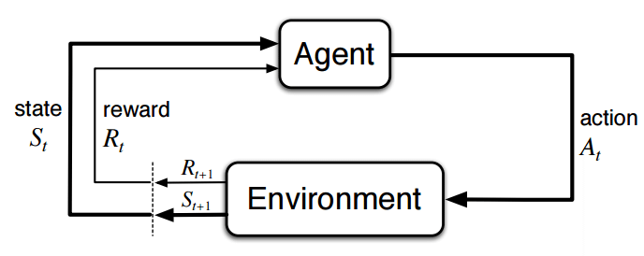
Reinforcement learning is studied in many disciplines, such as game theory, control theory, operations research, information theory, simulation-based optimization, multi-agent systems, swarm intelligence, and statistics.
The problems of interest in reinforcement learning have also been studied in the theory of optimal control, which is concerned mostly with the existence and characterization of optimal solutions, and algorithms for their exact computation, and less with learning or approximation, particularly in the absence of a mathematical model of the environment.

Slide 4
The purpose of reinforcement learning is for the agent to learn an optimal, or nearly-optimal, policy that maximizes the "reward function" or other user-provided reinforcement signal that accumulates from the immediate rewards. This is like processes that appear to occur in animal psychology. For example, biological brains are hardwired to interpret signals such as pain and hunger as negative reinforcements and interpret pleasure and food intake as positive reinforcements.
In some circumstances, animals can learn to engage in behaviors that optimize these rewards. This suggests that animals are capable of reinforcement learning

Slide 5
Basic reinforcement learning is modeled as a Markov decision process (MDP)
a set of environment and agent states, S
a set of actions, A, of the agent
P_{a}( s, s’) is the probability of transition state s to state s’ under action a
R_{a}( s, s') is the immediate reward after transition from
s to s' with action a.

Slide 6
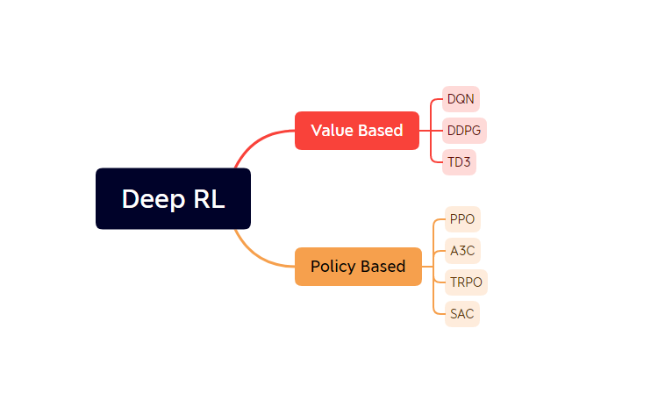
Classification of Deep reinforcement learning

Slide 7
Background of Truck Trailer Control

Slide 8
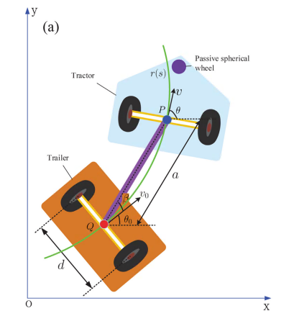
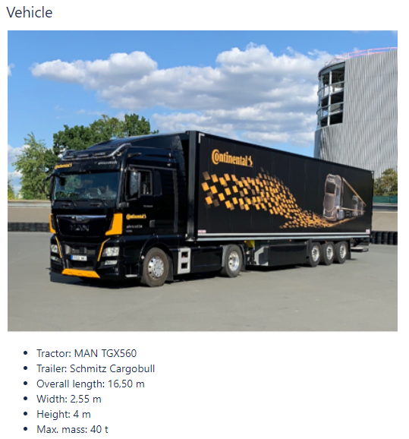

Slide 9
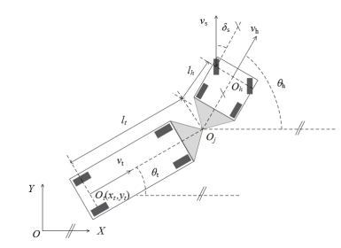
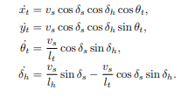
TT Kinematics

Slide 10
Experiments on Continuous Lane

Slide 11
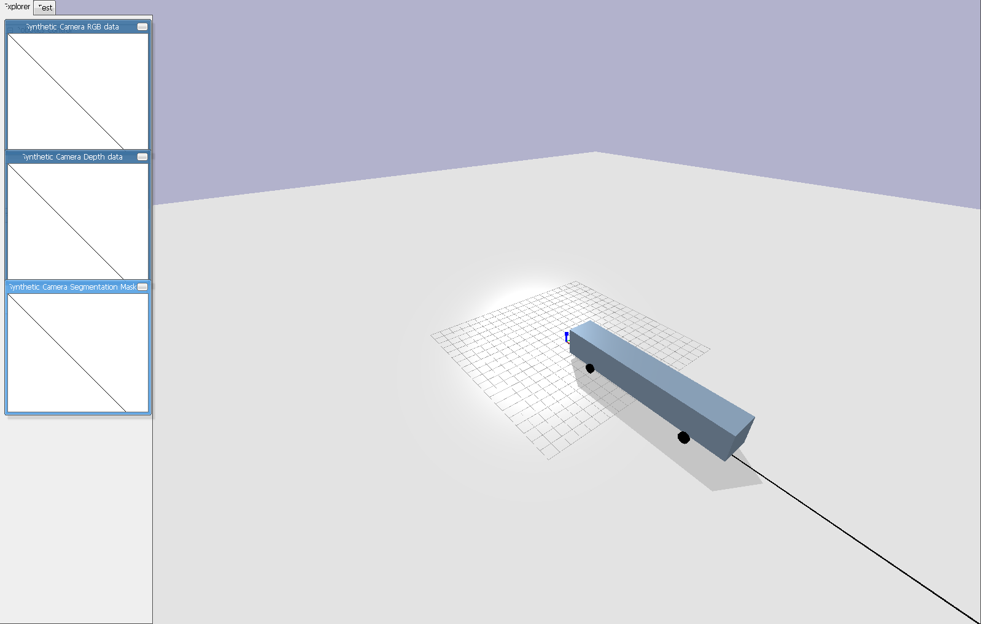
Initially we want to train the agent to follow a straight line and reach a target 200 meters away from the starting point. In the simulation world, we use the black line to serve as a reference line and use the bus model for training. The visualization of the environment v1 is shown below

Slide 12

Experiment Setting: Same State Space

Slide 13
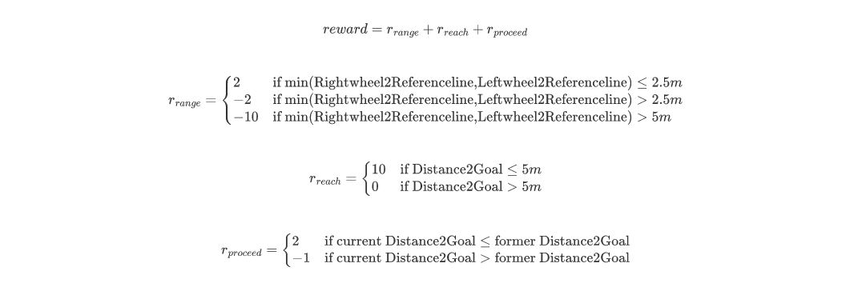
Experiments on Reward V1

Slide 14
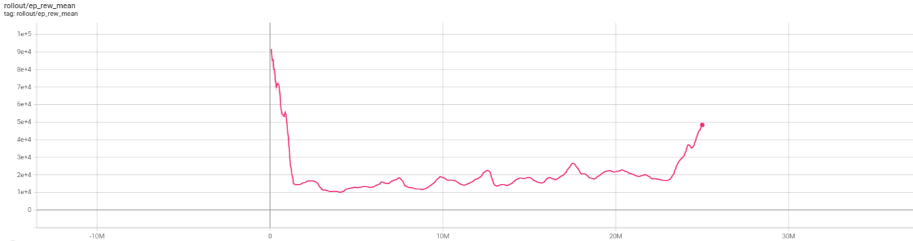
Results of Reward V1

Slide 15
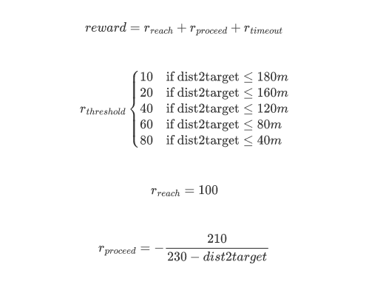
Experiments on Reward V2

Slide 16
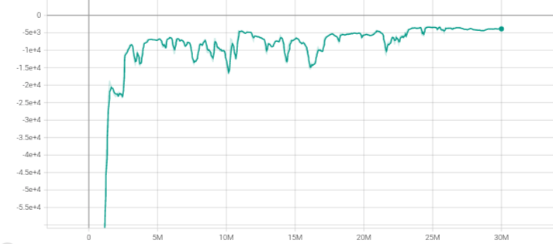
Results of Reward V2

Slide 17
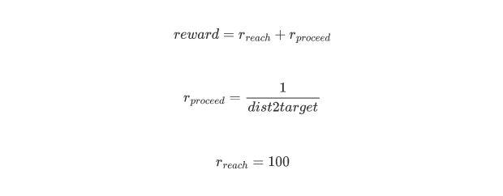
Experiments on reward V3

Slide 18
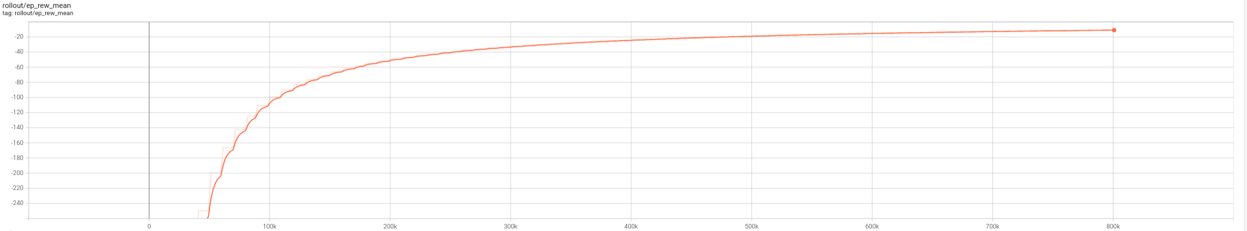
Results of Reward V3
ILD - Goal_Reaching for Bus Model - All Documents (sharepoint.com)

Slide 19
Conclusion
After checking the animation, we found that the agent can follow the reference line for some time and move forward, but still end up deviating from it. It makes us to think whether it is a good way to craft the issue like that. After discussion about that, we decide to change the environment, using a series of discrete way point to represent the reference path which is easily to shift its shape and the length of it can be infinite.

Slide 20
Experiments on Discretized Lane

Slide 21
Goal Reaching Task on Bus Model

Slide 22
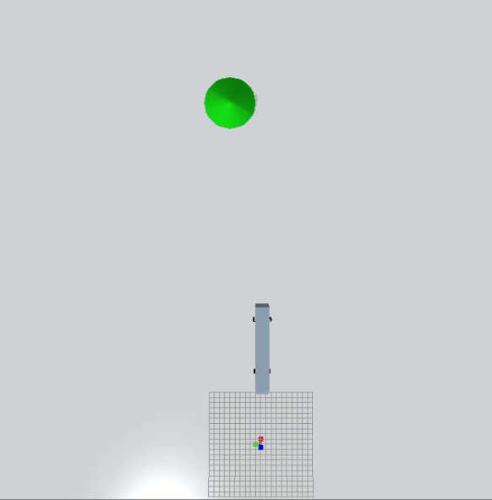
In this environment, we stick with the bus model and the target is shown in green in the simulation environment. To make the policy learning by reinforcement learning more robust, the goal will be generated randomly in a certain range: 50 to 100 meters in X-axis and -60 to 60 meters in Y-axis.

Slide 23
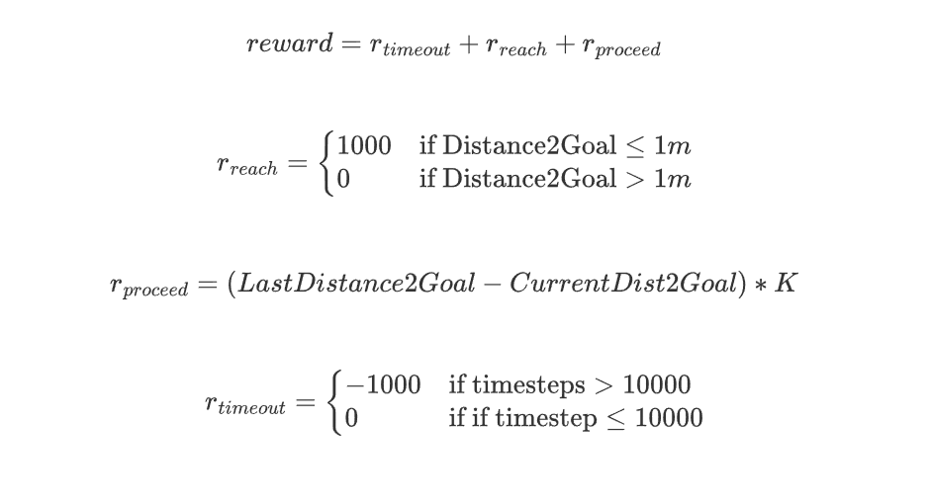
Experiment Setting : Same Reward function

Slide 24
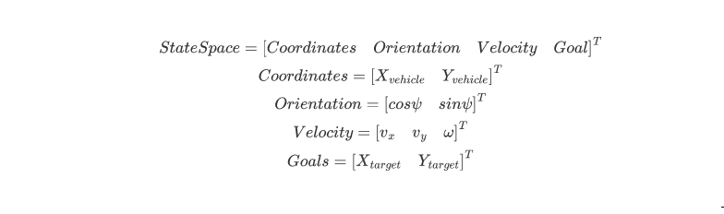
World Coordination Experiments

Slide 25
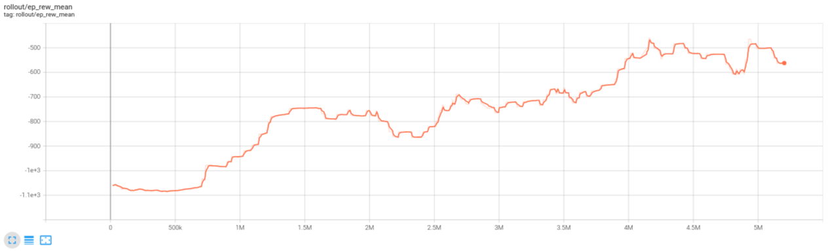
Training Results
ILD - State V1 - All Documents (sharepoint.com)

Slide 26
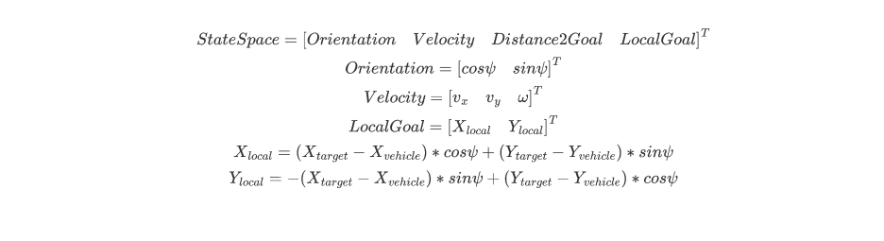
Local Coordination Experiments

Slide 27
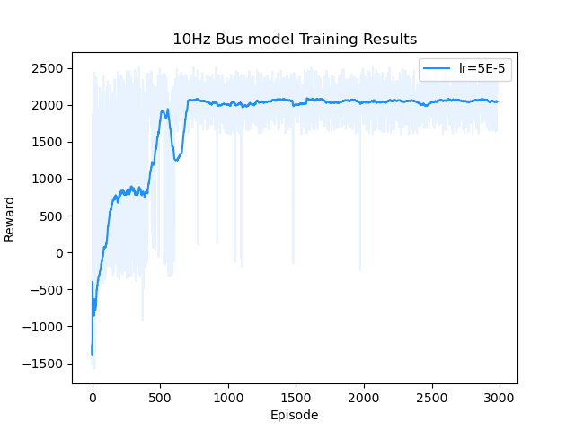
Training Results
ILD - video_lr=5E-5.mp4 - All Documents (sharepoint.com)

Slide 28
Conclusion
In this goal reaching environment, we suffer a lot from wrong observation space, unreasonable k setting and high learning rate. They all contribute to our previous failure. Luckily, we manage to solve them all step by step, and have a practical experience with tuning the parameter of reinforcement leaning environment. Goal reaching environment is only an intermediate stage for our project. Since we have succeeded in solving it, we can move forward to the track environment

Slide 29
Way points following task

Slide 30
Fixed Map Tracking Task on Bus Model

Slide 31
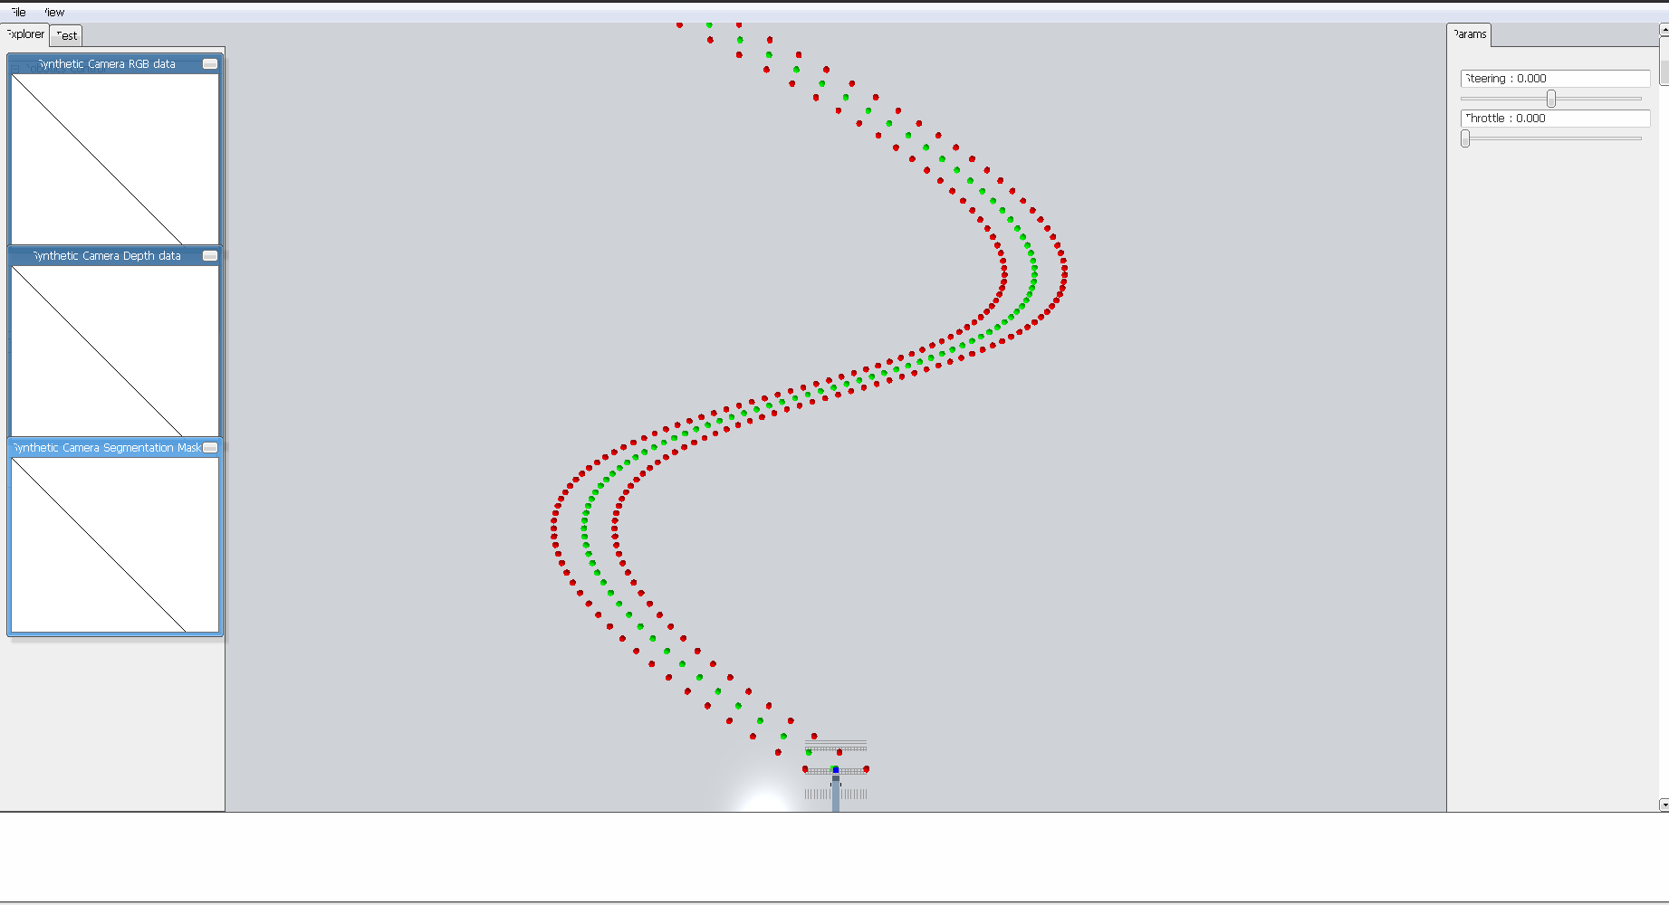
After getting satisfactory results from the last environment, we can move to the track scenarios which are more challenging than the previous one. Also, finishing the task needs the experience from the former experiment. In this scenario, the reference line is discretized and represented by green waypoints, the edges of the lane are represented by red points. The lane is formulated by the B-spline equation. Control points and other parameters are shown below, along with the visualization of the whole track.

Slide 32
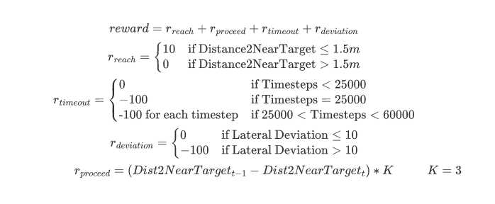
Experiment Setting

Slide 33
Parameters

Slide 34
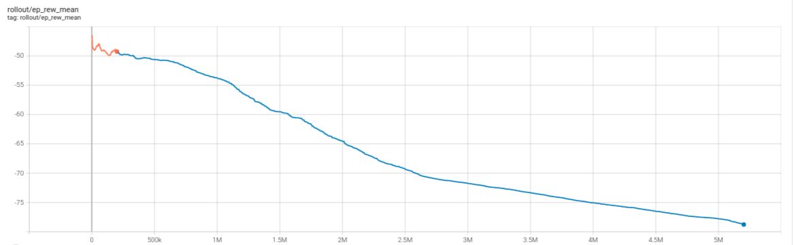
Experiment Results: Hard Constraint

Slide 35
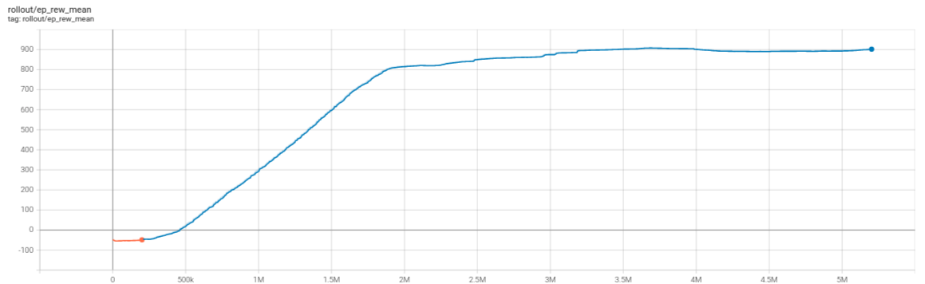
Experiment Results: Soft Constraint
1207video.mp4 (sharepoint.com)

Slide 36
Variant Map Tracking Task on Bus Model

Slide 37
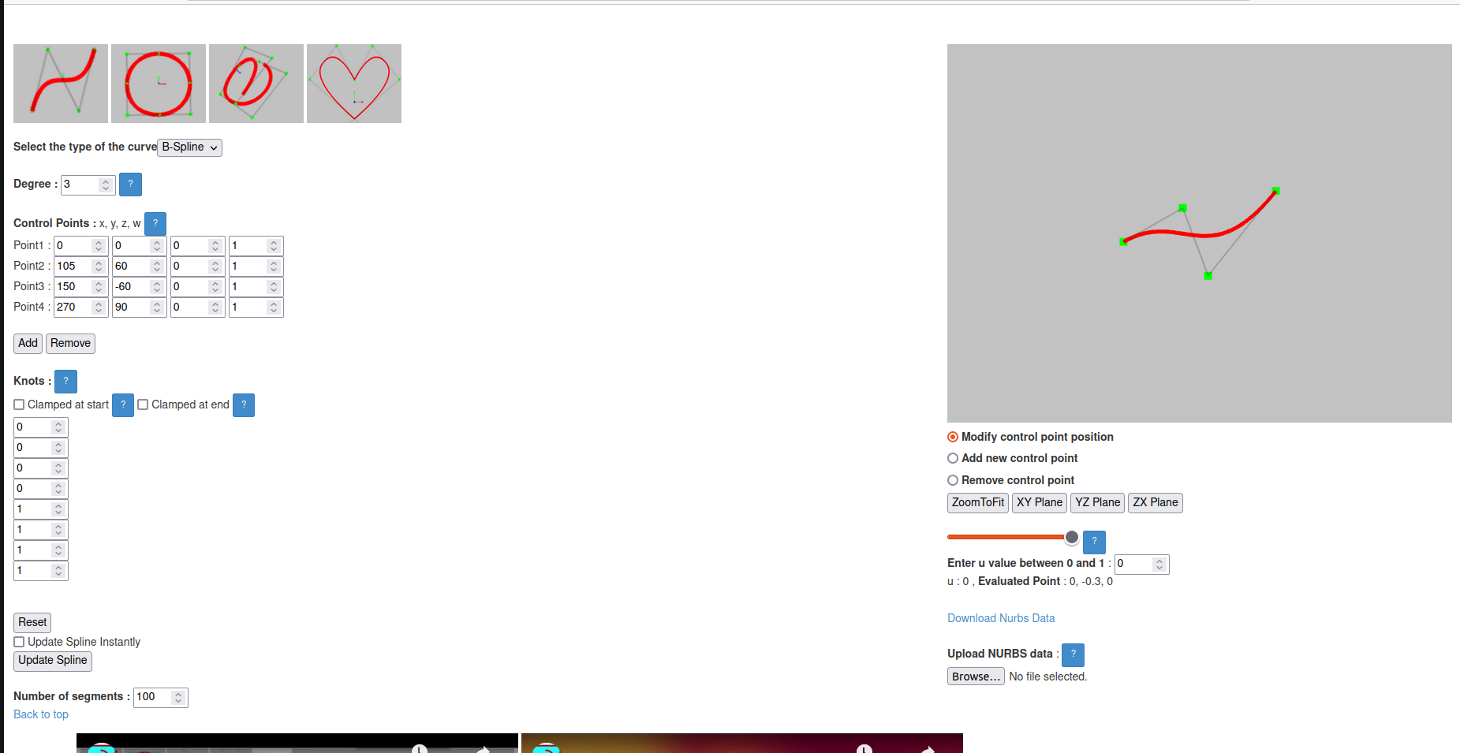
Map Generation
map_generation.mp4 (sharepoint.com)

Slide 38
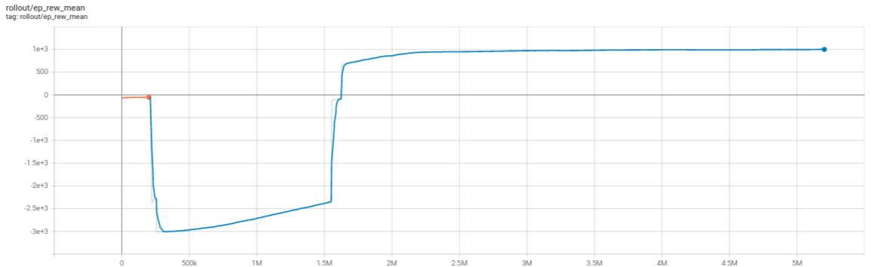
Training Results
random5_0110.mp4 (sharepoint.com)

Slide 39
Future work

Slide 40
Finish crafting the 3D Trcuk&Trailer model and put that into track environment
Adding speed profile into reward function using existing trained model

